Slide 1
Summary of AOA 21

Slide 3
AOA 21 - Our Goal:
To pursue improved quality and patient care through the delivery of a world recognised orthopaedic surgical education and training program
We may be good, but we want to be GREAT!

Slide 4
Survey and discernment -review of education and training program
Phase 1: As Is | Phase II: Leading Practices | Phase III: To Be | Phase IV: Roadmap
September 2012 – February 2013 | March 2013 | April – August 2013 | September 2013 – February 2014
Report #1 to Board | List of Leading Practices in Training | Report #2 to Board & Training Leaders | Report #3: Implementation Roadmap

Slide 5
The AOA 21 Project
Stage One (2014-2017)
Curriculum development
An assessment strategy, including a phased introduction of workplace based assessment
Development of the e-Learning platform
Alignment of Bone School with revised curriculum
Building capability of our Directors and Supervisors of Training
Notes:
Just to re-cap…. The project will run for eight years in total and has been broken down into two stages.
16 recommendations were created from the As Is and Leading Practices phases.
The AOA 21 project was launch in March 2014.

Slide 6
The AOA 21 Project
Work in each of the below areas has begun…
Stage Two (2018-2021)
Accreditation of training sites
Review of the selection process
A new research scheme
Continuing Professional Development (CPD)
Notes:
The below areas are now all under development / phased implementation…
- Review of accreditation standards, policies and processes commenced in 2017
- Revised research requirements developed and launched for 2017 training cohort
Annual selection review cycle already in place
New CPD program and online system launched in 2017

Slide 7
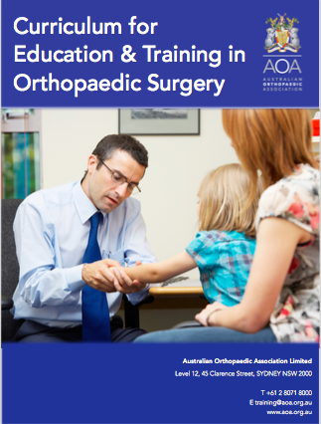
Revised Curriculum
What are the essential abilities
of an AOA graduate
on their first day
of independent practice?

Slide 8
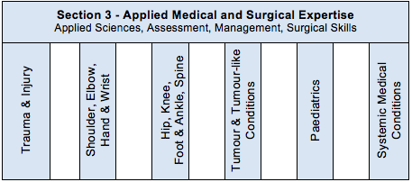
Development of a revised Curriculum Framework
Notes:
Curriculum divided into three sections …
Trainees will be ‘signed off’ for each of the topic areas of the curriculum.

Slide 9
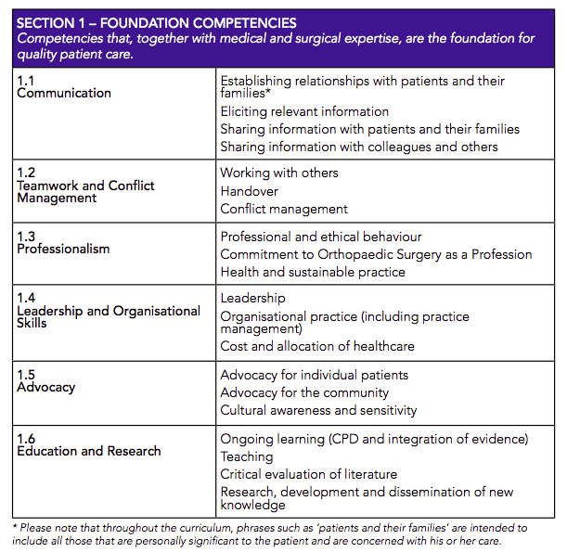
Focus on development of Foundation Competencies in training of orthopaedic Surgeons
- explicit teaching
Notes:
More detail on Section 1

Slide 10
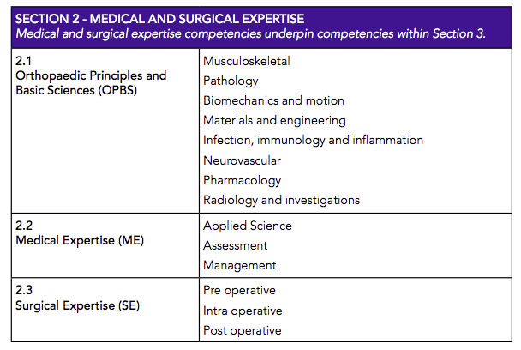
Notes:
Knowledge related competencies in Section 2.1 will be assessed by the OPBS examination.
General medical and surgical expertise competencies apply to all cases … and specifics are provided within topic areas.

Slide 11
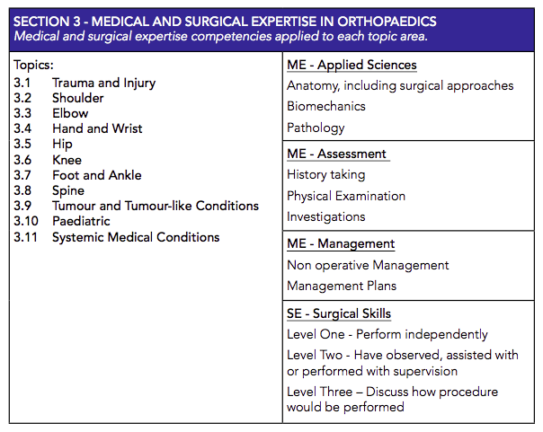
Notes:
Each topic area is broekn down into applied sciences, assessment, management and surgical skills

Slide 12
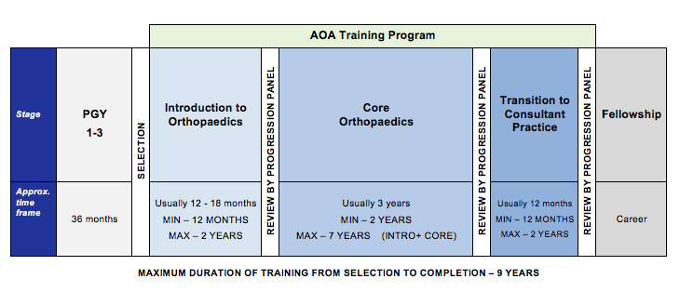
Stages of Training - focus of program moves from time-based to competency- based
Notes:
Instead of 5- one year stages of training (SET1-5) we have created more defined stages of training. Talk through minimums and maximums for each stage.
There are specific requirements a trainee must meet for each stage, and they will present for review at the end of the stage to check requirements have been met AND they meet the expectations of training for that particular stage.
In this training framework, trainees sit for the Fellowship Examination at the end of the Core Orthopaedics phase, after they have met some eligibility requirements. In the Transition to Practice phase, trainees narrow focus slightly to concentrate on specific areas of interest, build confidence in working more independently.

Slide 13
New Assessment Strategy – new assessment tools supported by new technology including a Training App
Notes:
Flick through this slide and the next quickly … need to show the research basis.

Slide 14
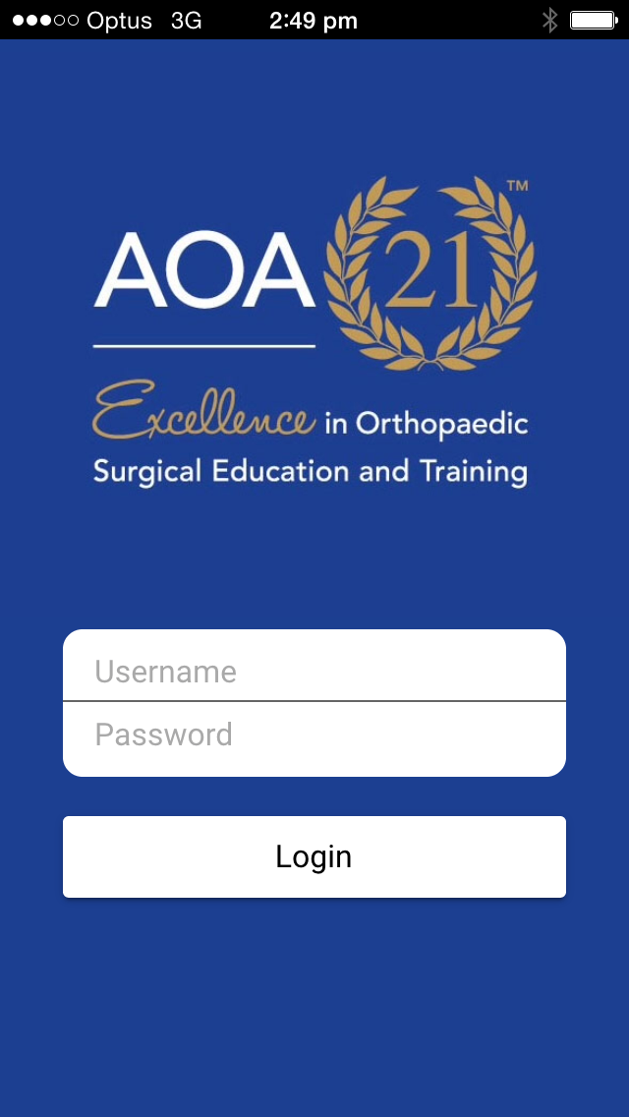
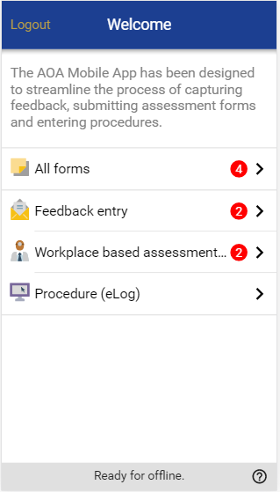
AOA Training App – launched Feb 2017
Accessible via all smartphone devices
Easy to use
Feedback Assessments can be completed in 60 secs or less
Syncs with AOA Trainee Information System
Notes:
To prompt more ad hoc feedback on observed behaviour AOA has developed the Trainee Feedback App.
Makes it easy for trainees/supervisors to quickly and progressively log assessments.
It’s a web-based App created using functionality similar to that of email so it is very intuitive.

Slide 15
Trainees
MASTERY
Learning/
Change
Aha! Awareness
Non-consciously Incompetent
Consciously Incompetent
Non-consciously Competent
Consciously Competent
Gordon Training International, Noel Burch (1970s)

Slide 16
Workplace Based Assessment (WBA)
Four different types of workplace based assessment (WBA):
Patient Consultation Assessment (PCA)
Management Plan Assessment (MPA)
Case based Discussion (CbD)
Surgical Skills Assessment (SSA)
Formative assessment: the aim is trainee learning
Notes:
Consider the main areas of practice and designed forms accordingly ….
Four different types of WBA
Please remember that the aim of workplace based assessment is trainee learning. Trainees should be observed assessing or managing patients that are the right case complexity to allow feedback on practice points they need to improve or refine.
Patient Assessment Forms are more suited to trainees in the earlier years of training, while Case based Discussion assessments are more appropriate for trainees with more experience. Surgical skills will be used at all levels of training – the difficulty of the procedures assessed will be increased as the trainees gain more experience. A Multi source Feedback assessment will be conducted at each stage of training.

Slide 17
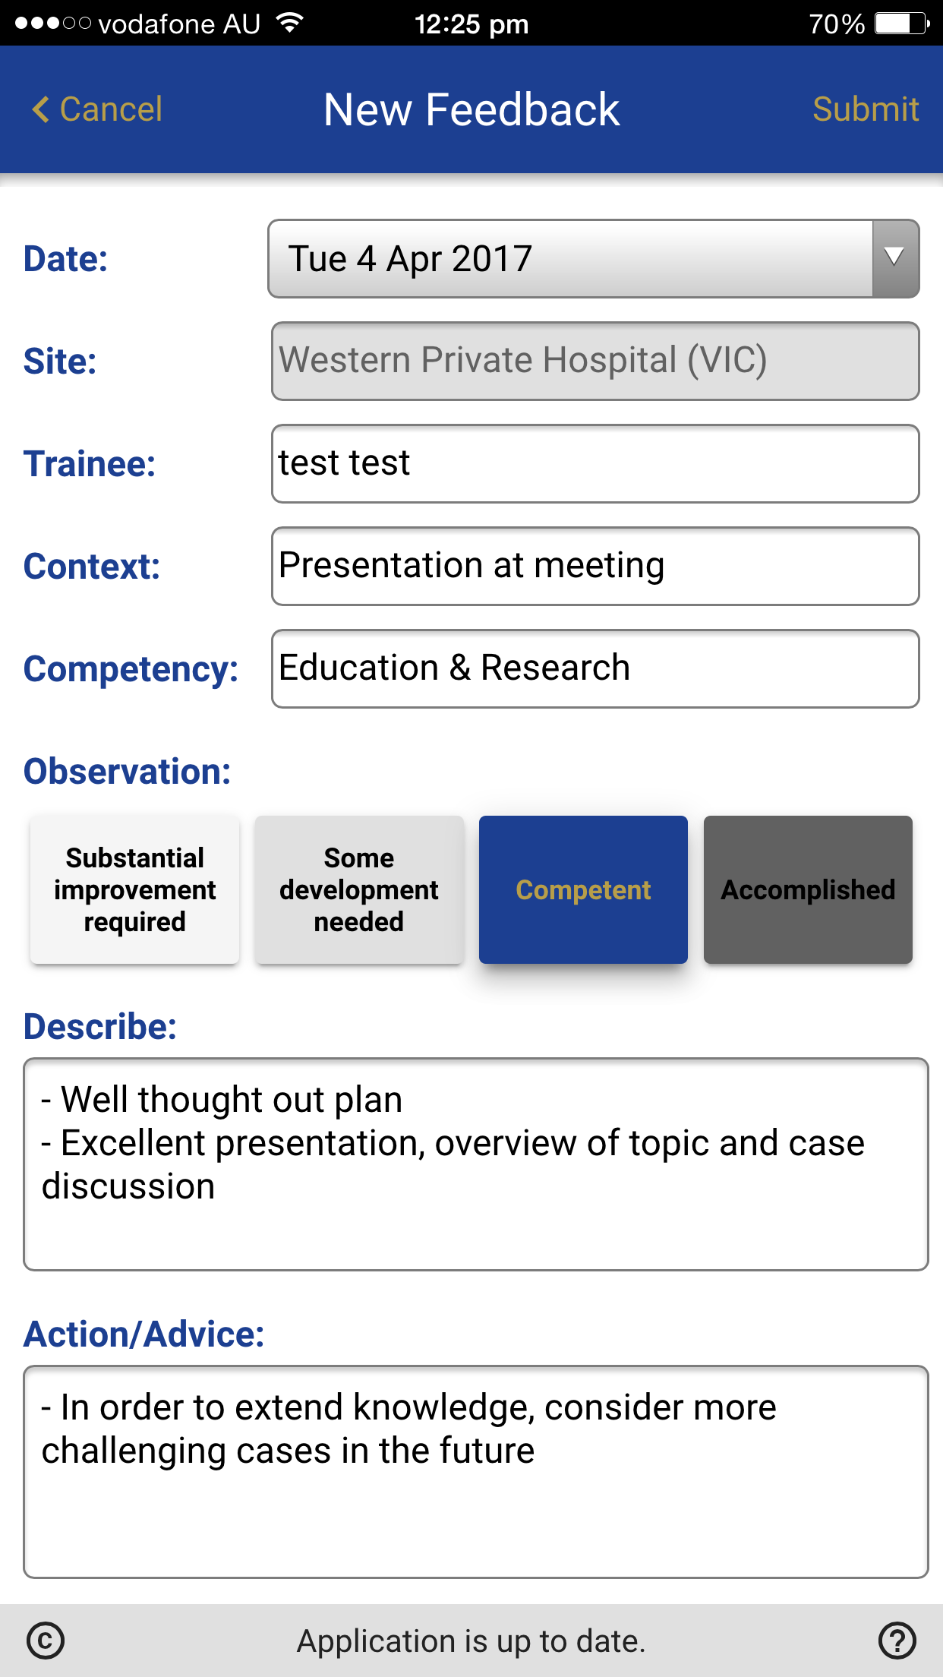
Feedback on Specific competencies
Provide feedback on foundation (non-technical) competencies, i.e. not just medical and surgical expertise. For example:
Communication on the ward
Teamwork in theatre
Decision-making while on call
Presenting at a meeting
Professionalism observed in the ED
Shute (2008), Hattie & Timperley (2007), Goodman et al (2004)

Slide 18
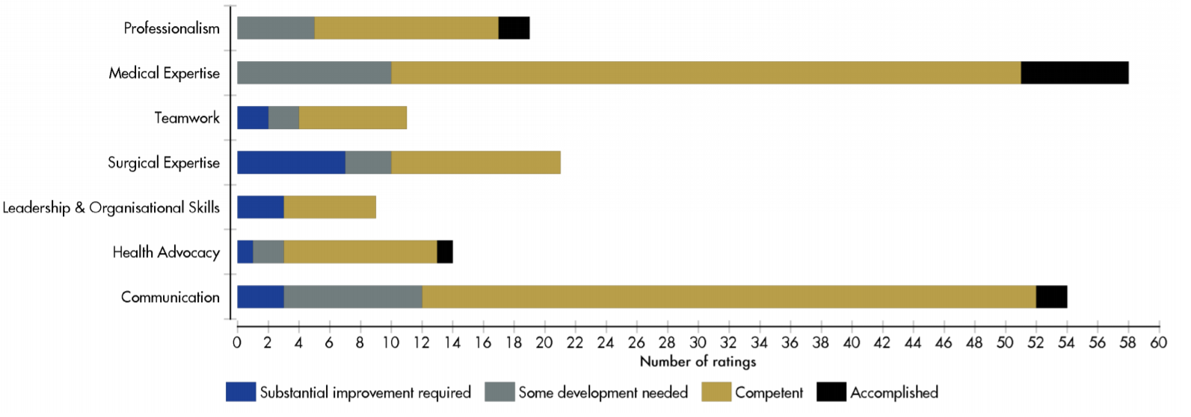
Aggregated data available trainee progression evidence based with many data points
Notes:
Silver is competent here … teamwork and leadership and organisational skills seem to be more of an issue.

Slide 19
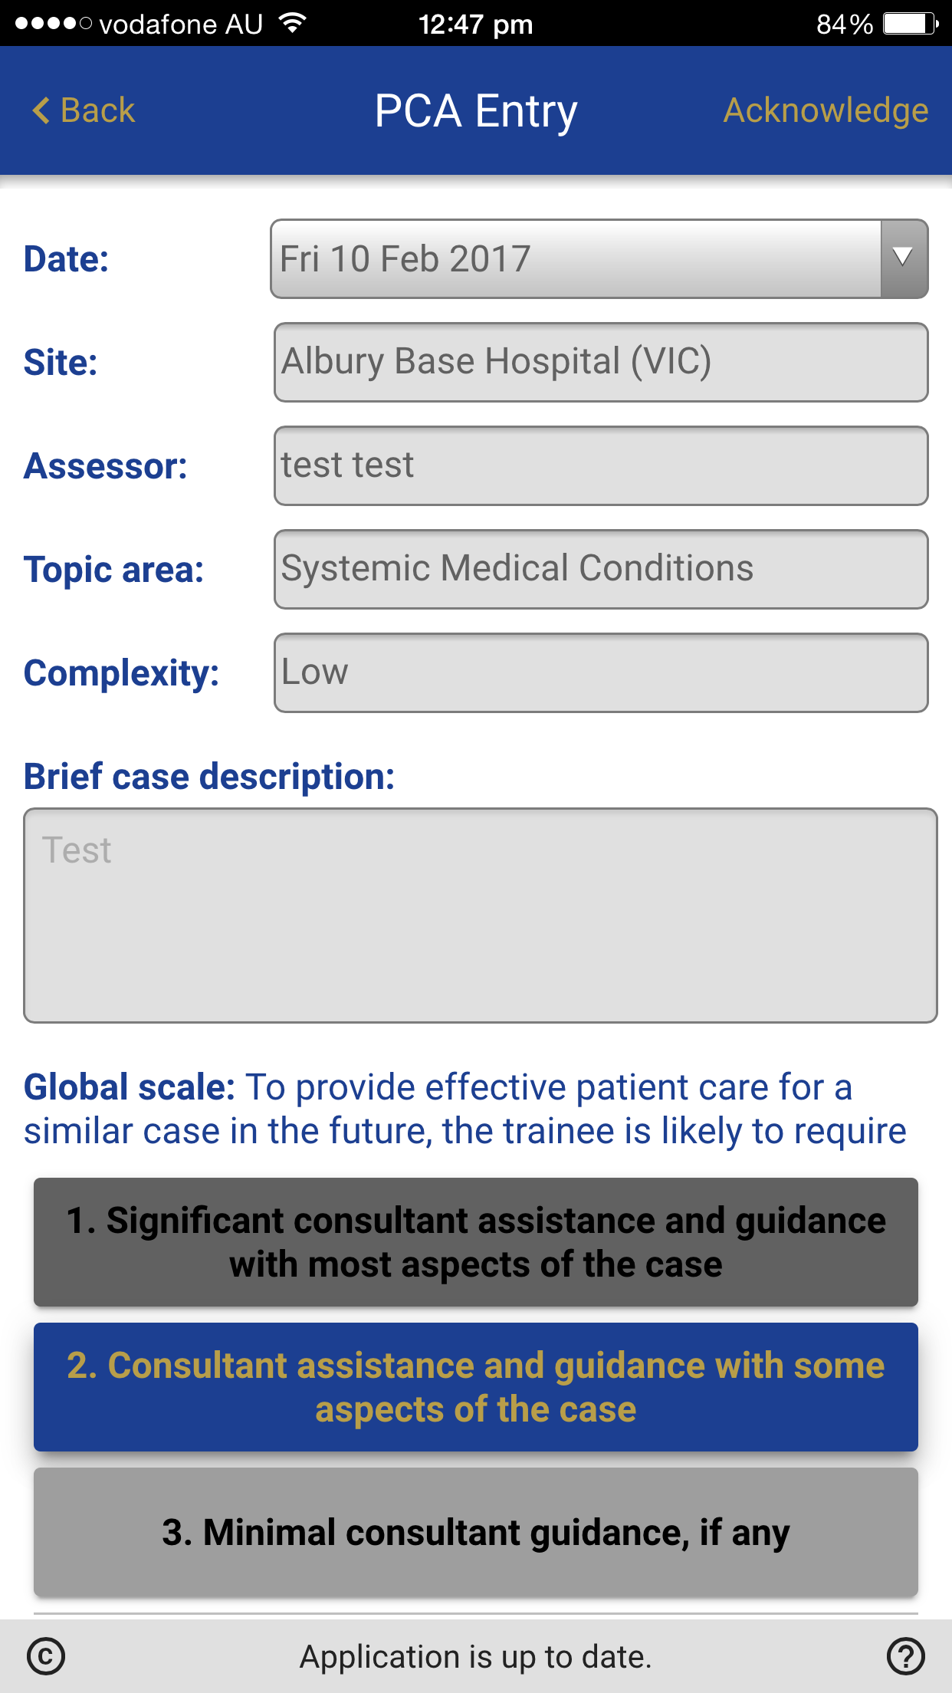
Readiness for Practice
For WBA, rating system based on trainee’s readiness for practice using entrustment
Walther et al (2009), Van der Vleuten et al (2005)
For Feedback App, rating system based on standard of independent practice
Gofton et al (2012)

Slide 20
AOA Training App - eLog
Trainees log every procedure via the App or TIMS
eLog procedure lists revised
Considered ‘old’ eLog list
Revised terminology to align to curriculum
Tagged procedures as Level 1, 2 or 3
Included other procedure that are not in the curriculum though trainees may wish to log
Monitoring data over time to ensure competency in Level 1 skills is achievable
Notes:
eLog data will be used more effectively in the new program to ensure trainees complete the program with adequate exposure to all level 1 procedures. Procedures in the eLog have been labelled with the corresponding level (if applicable)
We will also be able to use the data for accreditation of training sites.

Slide 21
AOA 21 Monitoring and Reviews
3-monthly review with Trainee Supervisor
Feedback entries
Workplace based Assessment
eLog
6 monthly reviews with Director of Training
Discuss 3 monthly reviews
Consider progress with requirements for stage of training
Orthopaedic Module completion
On track with expectations of stage?
Notes:
Instead of QARs … in the future

Slide 22
Revised Research Requirements
Key features
Choice of three pathways
Project pathway
Coursework pathway
PhD pathway
Collaboration on research completed for project pathway
Support for trainee interested in becoming a surgeon scientist
Recognition of prior learning and completed research
Completion after the Fellowship Examination
Notes:
Focus on completing orthopaedic modules in preparation for the Fellowship Examination during core, together with making progress on research. Can complete research at any time but must complete to a satisfactory standard before admission to Fellowship

Slide 23
Building Capability
AOA 21 Workshops – each 2hrs duration
AOA 21 Overview
Trainee Rotations – A Planned Approach*
Workplace Based Assessment*
Effective Feedback*
Helping Underperforming Trainees*
Teaching in the Clinical Setting
Regional Leads trained to deliver workshops
5 CPD points per workshop.
* Exemption from the RACS Foundation course.
Notes:
Could mention about RACS mandatory training for Fellows involved in training … mention the four workshops etc

